Slide 1
Assessment at Codsall Middle School
How are we developing assessment to maximise the learning of our pupils?

Slide 2
Why do we assess?
Assessment helps us to…
check how we’re doing
check how our pupils are doing
check what pupils need to learn next

Slide 3
However, we also really need assessment to…
tell pupils where they are going,
how they are doing,
and where they need to go next
Pupils can take responsibility for their learning and understand how to move forward
So that

Slide 4
To check how we’re doing
SATs – in Year 6 after 5 terms at CMS. Two years of the progress made in Y3 and 4 before pupils join us.
GL Assessments – used every year in CMS. It compares our achievement to other schools nationally.
GL Assessments Progress Tests in Maths and English – nationally validated tests that are taken by a large number of schools across the country.
Taken on the computer (headphones essential!) and externally marked.
Used by the school and by OFSTED to make sure we’re doing a good job.

Slide 5
SATs – in Year 6 (after 5 terms at CMS). Two years of the progress made in Y3 and 4 before pupils join us.
GL Assessments – used every year in CMS. It compares our achievement to other schools nationally.

Slide 6
To check how our pupils are doing
GL Assessments at the end of every year. Also shared with Codsall High School when pupils leave us in Year 8.
On a day-to-day basis, pupils are assessed against subject specific Key Assessment Criteria.
Used by senior leaders and teachers to make sure that groups of pupils and individual pupils are making good progress. It helps us work out who needs more support.

Slide 7
GL Assessments show us how a pupil is attaining and the progress they have made since the last test.
It helps us work out who needs to have more support and informs the groups that pupils will work in.
This information is also shared with Codsall High School when pupils leave us in Year 8.

Slide 8
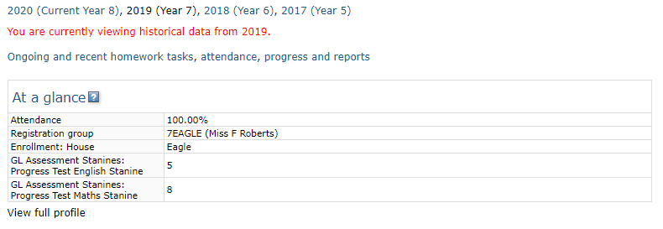
Click here
Stanine
9 | Above Average
8
7
6 | Average
5
4
3 | Below Average
2
1
GL stanines for English and Maths

Slide 9
To tell us what pupils need to learn next
GL Assessments at the end of every year.
KAC – constant monitoring of the KAC pupils still need to achieve
Pre and post assessments completed just before and just after a section of learning.
Used by teachers to find out what pupils already know and what gaps there are in their learning. Teachers then adapt planning to meet those needs.

Slide 10
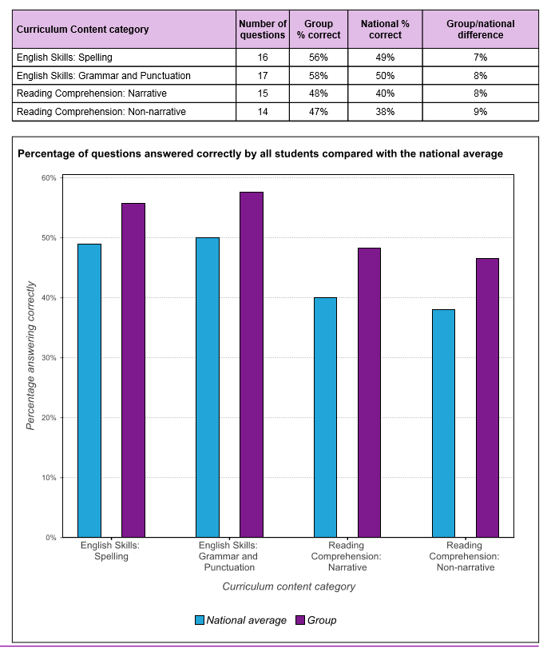
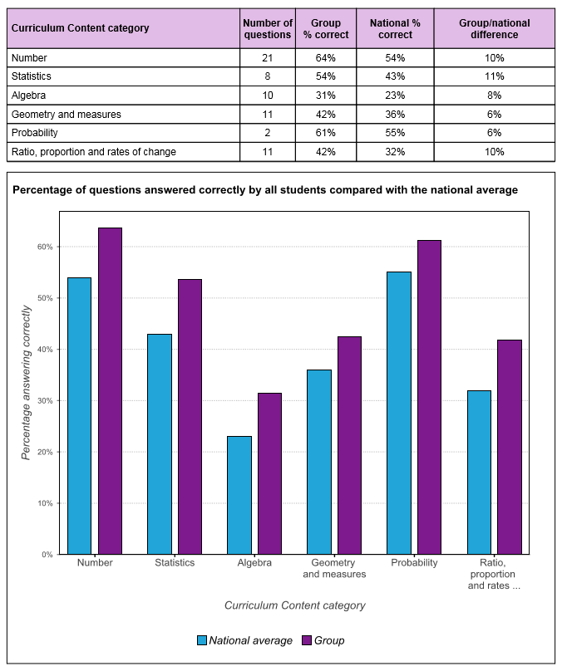
GL Assessments give us detailed information about how we are doing in different aspects of English and Maths.

Slide 11
Even more detailed information…
How do our pupils compare?
Specific questions

Slide 12
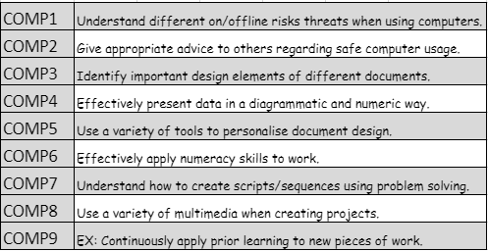
Day-to-day Assessments
On a day-to-day basis, pupils are assessed against subject specific Key Assessment Criteria – known in school as KAC.
As pupils master the skills/knowledge needed for a Key Assessment Criterion, they gain points. We use these points to measure pupils’ attainment and progress against age related expectations.
Parents will see these assessments on reports, expressed as Developing, Meeting or Exceeding.

Slide 13
How our Key Assessment Criteria work
Pupils move along a scale, reflecting where they are against year group expectations:
All pupils start at the beginning – they haven’t done any of the year group content yet
Halfway through the year, they may have mastered enough skills to be here
Or here...
By the end of the year, we’d hope they would be here.
Or here...
Beginning
Developing
Meeting
Exceeding

Slide 14
A change in focus based on research into what helps pupils make the best progress. Our aim: developing assessment capable learners…
…who know…
where they are going
how they are doing
where they need to go next

Slide 15
What is an assessment capable learner?
An assessment capable visible learner is a pupil who is independent and takes responsibility for their own learning.
They know their starting points, their learning goals and the journey they need to take to achieve those goals.
They can answer these questions:
Where am I going?
How am I going?
Where to next?
They are active and engaged in their learning.
They understand assessment tools being used and what their results mean. They know how well they have done and what they need to do to move their learning forward
They understand the learning intentions of each lesson.
They use success criteria to know if they have achieved the learning intention.

Slide 17
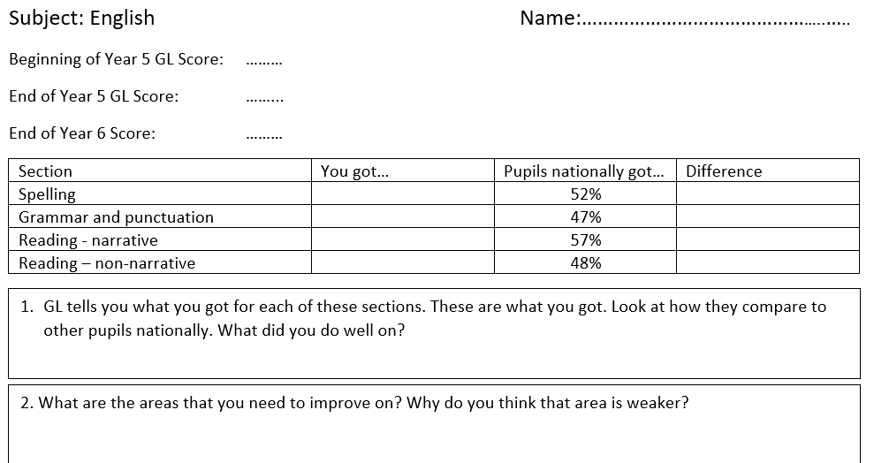
We are sharing more detailed GL information with pupils and asking them to reflect on the three questions
Where are you going?
How are you doing?
Where do you need to go next?

Slide 18
Where are you going?
How are you doing?
Where do you need to go next?
Anna
4
4
+1%
51%
-8%
39%
+11%
68%
+1%
49%

Slide 19
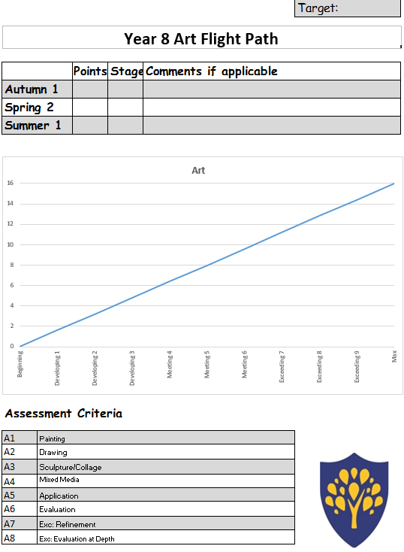
We share the information from KAC assessments using flight paths. Pupils have a flight path for each subject.
5
D3
8
M5
Target
Where are you going?
How are you doing?
Where do you need to go next?

Slide 20
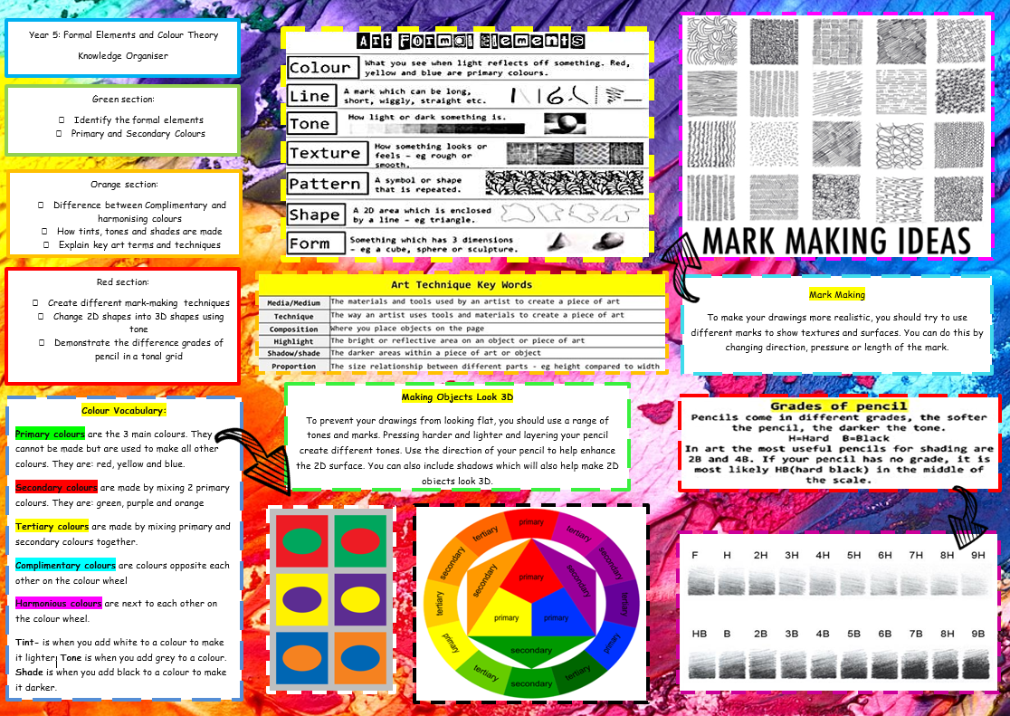
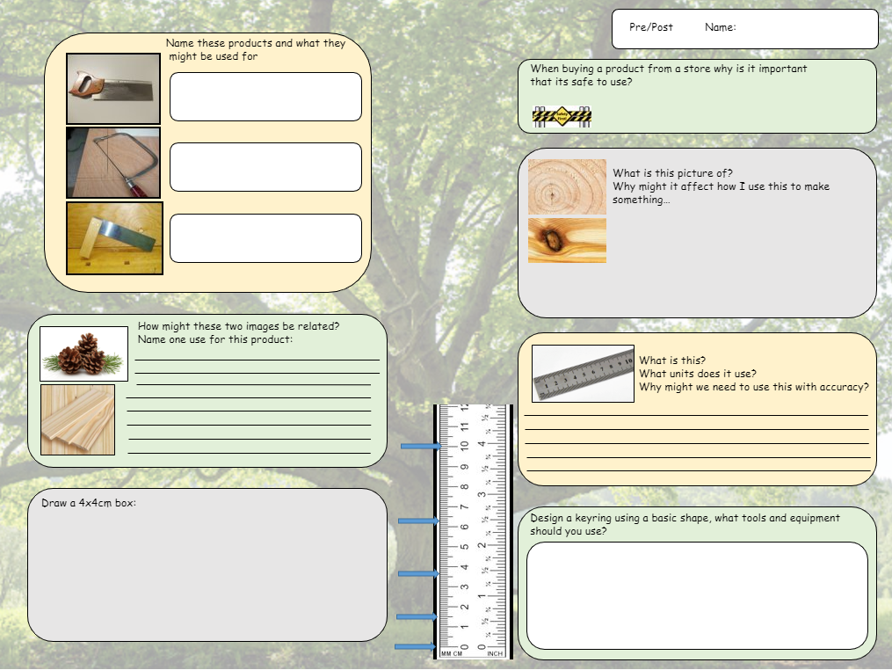
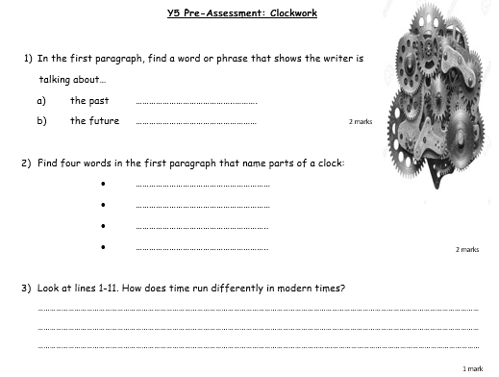
We’ve introduced pre-testing and post-testing:
To help teachers to identify gaps in pupils’ learning
To help pupils understand what they are going to be learning, what they already know and what need to learn to get there.
Where are you going?
How are you doing?
Where do you need to go next?

Slide 21
How will we share important information with parents?
Through the Go4Schools Desktop site – GL information and previous reports are always available online.
In pupils’ school books. We will also be putting them in the pupils’ planner – but first we will finish trialling the best ways of communicating the information in a way that the pupils will understand, retain and use.
On Reports and Parents’ Evenings – dates are on the website.
First interim progress reports are at the end of this term.
Y5 and Y7 Report published Thurs 21 Nov
Parents’ Evening Wed 4 Dec
Y6 and Y8 Report published Fri 19 Dec
Parents Evening Mon 13th Jan

Slide 22
How can you help?
Ask your child to tell you what they thought about their GL Results in English and Maths.
What are they good at? What did they do last year that made them good at that?
What do they need to work on? What can they change to help them improve?
If they can’t remember, don’t worry. We’re trying to find the best way of sharing the information but it will take time!
MOST IMPORTANTLY…
Talk to your child about their learning using the 3 key questions. The more they talk about what they’ve learnt, the more they will retain it and use it.
Use the language of the 3Rs when you discuss your child’s learning. Encourage them to be…
Reflective
Resilient
Responsible
Where are you going?
How are you doing?
Where do you need to go next?

